Slide 1

Multiple Disease Prediction System Using Machine Learning
By-
Abhishek Awhale (2019-B-24072000B)
Shubham Pathare (2019-B-28102001B)
Priyanka Narsale (2019-B-05-82001B)
Supervisor Name
Prof.Govindharaj

Slide 2
Contents
Introduction
Objectives
Methodology
Results and Discussion
Conclusion
Future Scope
References

Slide 3
Introduction
Machine learning has become a popular technique for predicting various diseases. In this presentation, we will discuss the use of machine learning in predicting three major diseases: diabetes, heart disease, and Parkinson's disease.
The early detection of these diseases can significantly improve patient outcomes and reduce healthcare costs.
By using machine learning algorithms, we can accurately predict the likelihood of developing these diseases, allowing for early intervention and treatment.

Slide 4
Objectives
To detect the Various Diseases through the examining Symptoms of patient's using different techniques of Machine Learning Models. To Handle Text data and Structured data is no Proper method. The Proposed system will consider both structure and unstructured data.
In multiple disease prediction, it is possible to predict more than one disease at a time. So the user doesn't need to traverse different sites in order to predict the diseases. We are taking three diseases that are Liver, Diabetes, and Heart. . As all the three diseases are correlated to each other.

Slide 5
Diabetes Prediction
Diabetes is a chronic disease that affects millions of people worldwide. Machine learning algorithms can help predict the risk of developing diabetes by analyzing various factors such as age, BMI, family history, and lifestyle habits.
By using data from electronic health records and other sources, machine learning models can accurately predict the risk of developing diabetes. This allows healthcare providers to identify high-risk patients and provide targeted interventions to prevent or delay the onset of the disease.

Slide 6
Heart Disease Prediction
Heart disease is the leading cause of death worldwide. Machine learning algorithms can analyze various risk factors such as blood pressure, cholesterol levels, smoking status, and family history to predict the likelihood of developing heart disease.
By accurately predicting the risk of heart disease, healthcare providers can identify high-risk patients and provide targeted interventions such as lifestyle modifications, medication, or surgery to prevent or manage the disease.

Slide 7
Parkinson's Disease Prediction
Parkinson's disease is a neurodegenerative disorder that affects movement and cognition. Machine learning algorithms can analyze various factors such as age, gender, family history, and motor symptoms to predict the likelihood of developing Parkinson's disease.
Early detection of Parkinson's disease is crucial for effective treatment and management. By using machine learning algorithms to predict the risk of Parkinson's disease, healthcare providers can identify high-risk individuals and provide targeted interventions to slow disease progression and improve patient outcomes.

Slide 8
Methodology
Data collection
Data preprocessing
Model development
Model evaluation
Implementation

Slide 9
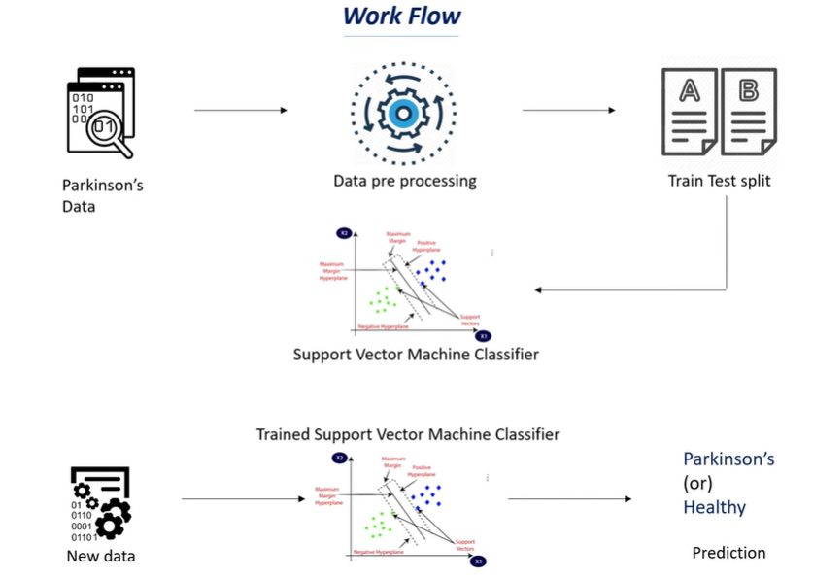
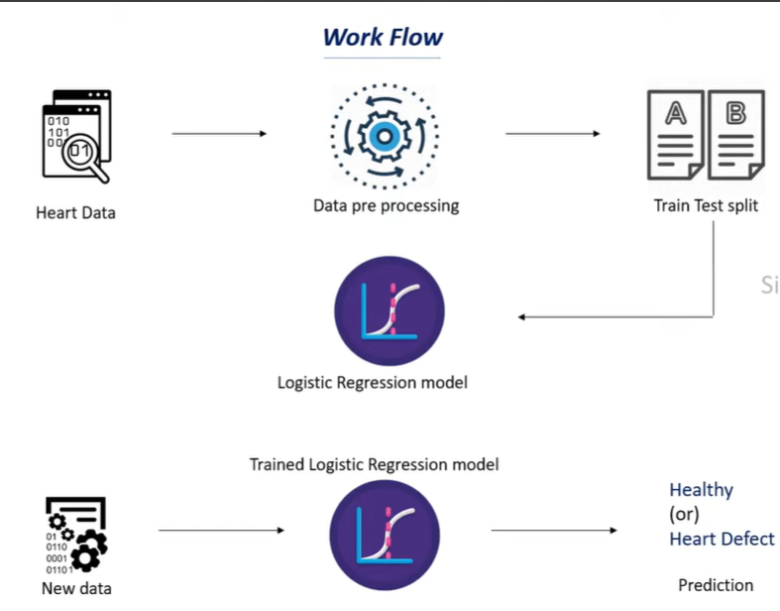
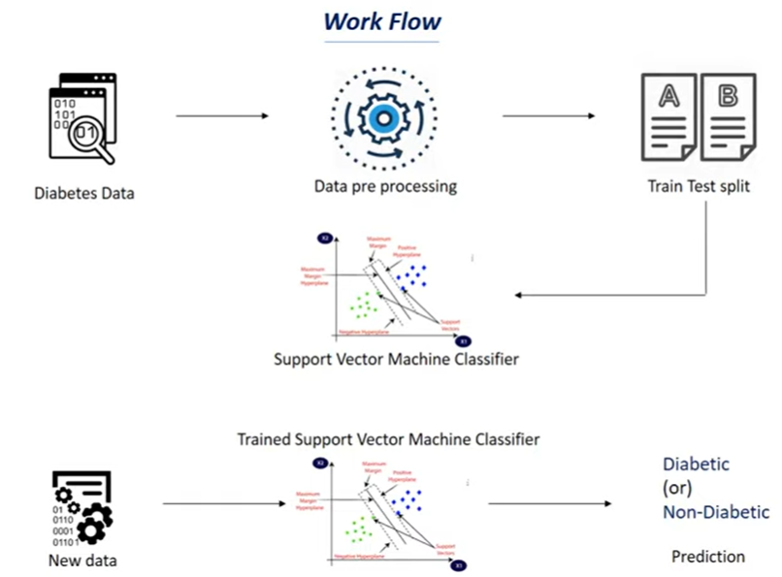
Architecture
Multiple disease System Webapp
Pickle File

Slide 10
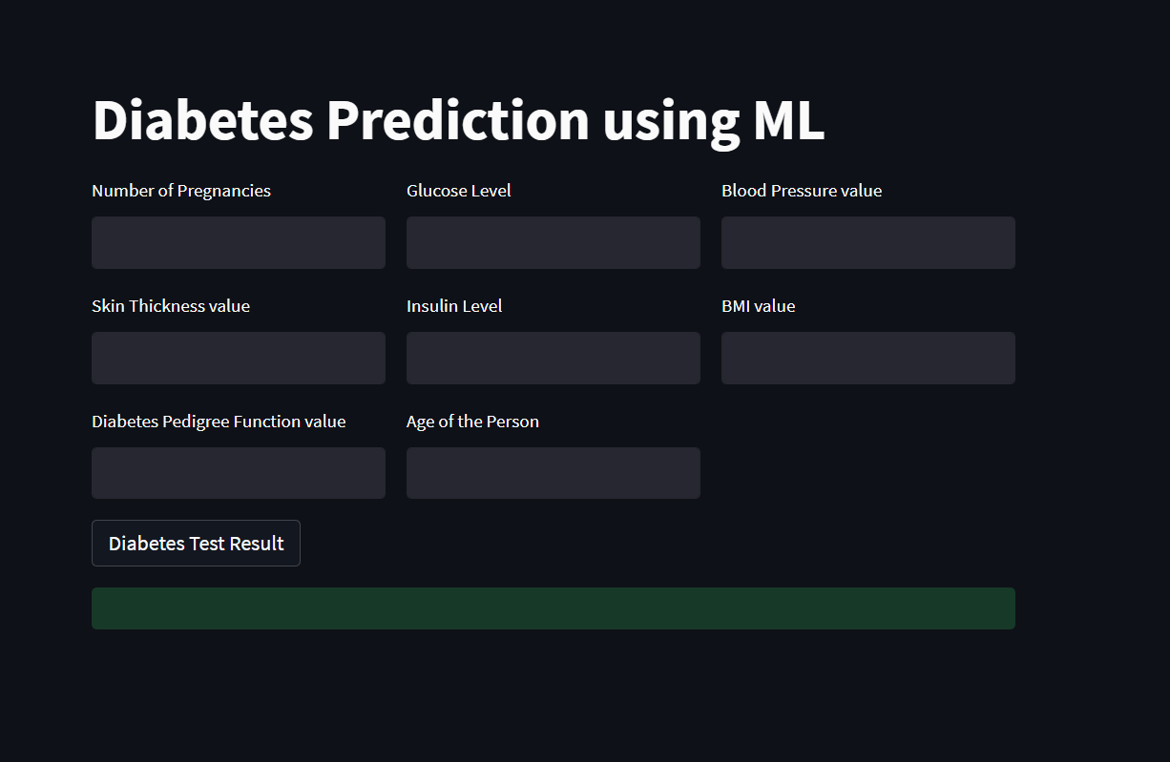
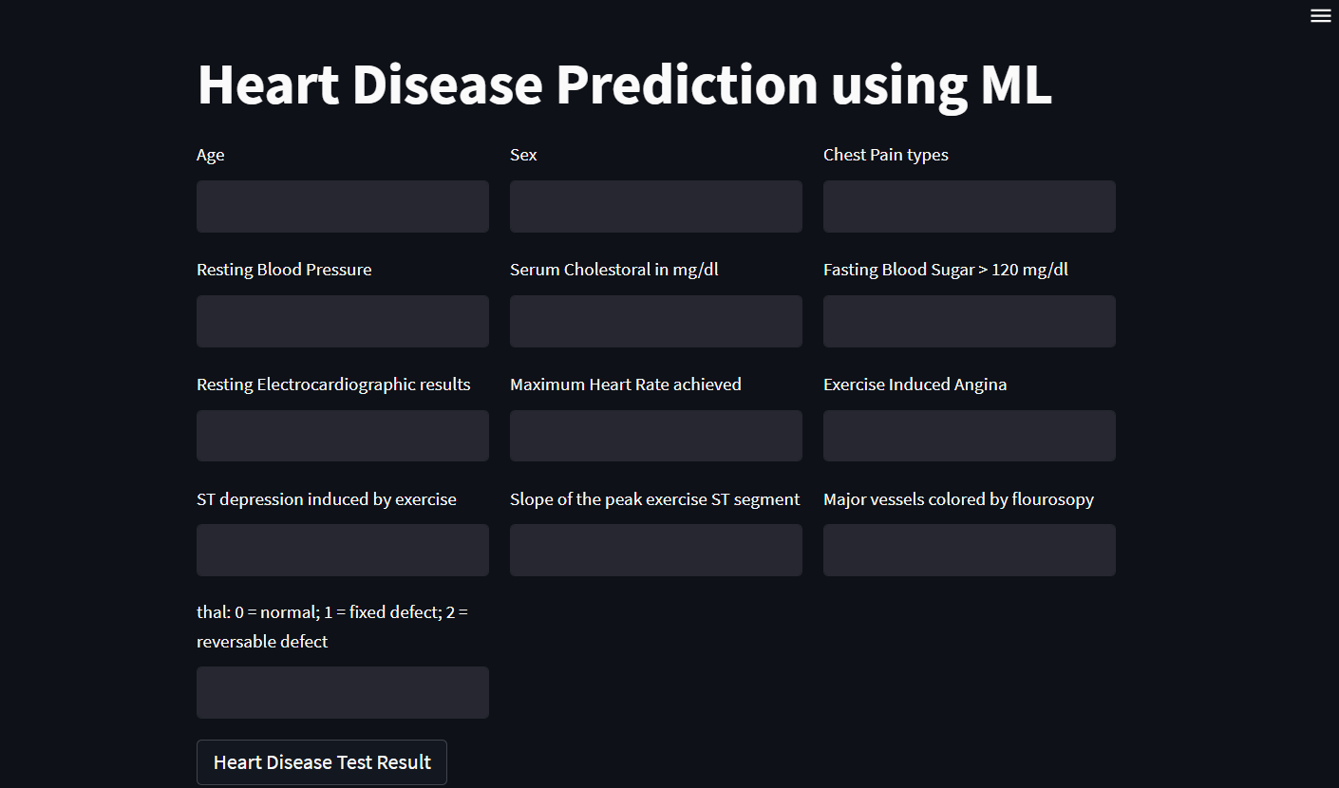
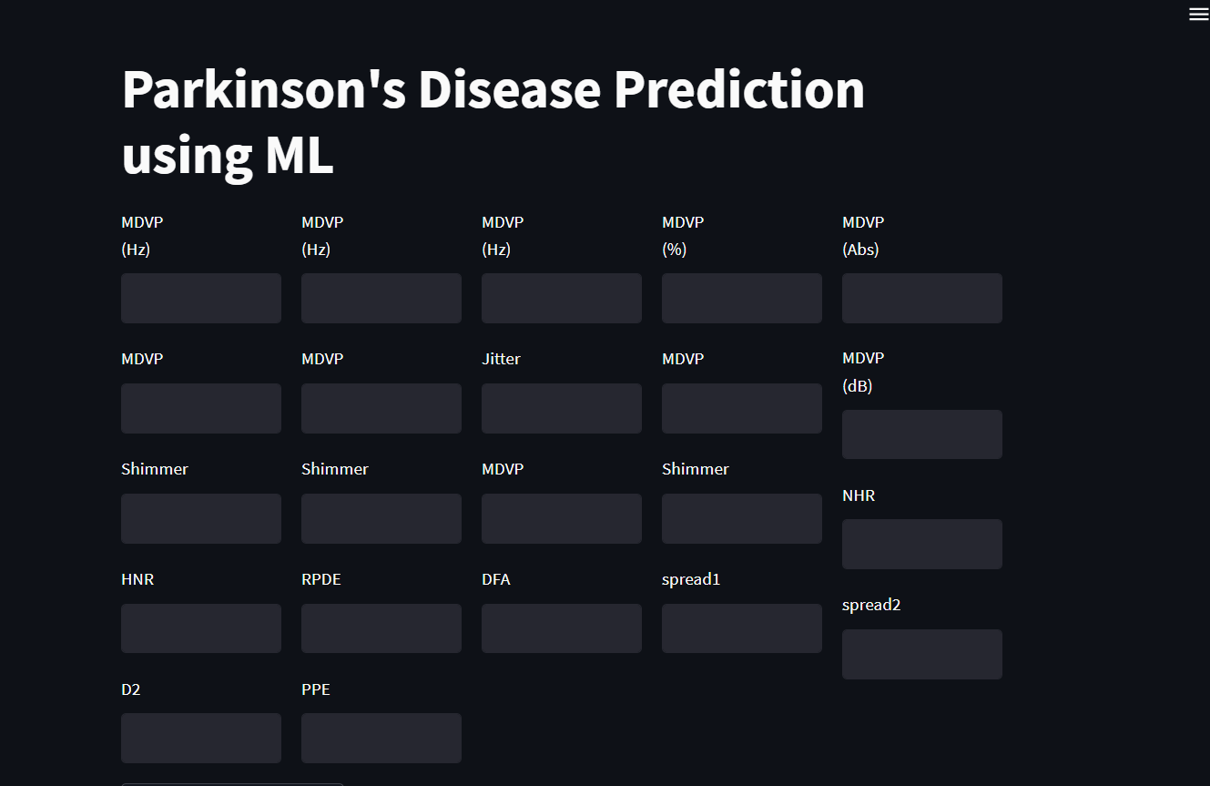
Results :

Slide 11
Conclusion
Machine learning-based approaches have shown promising results in multiple disease detection using clinical data. The reviewed studies highlight the potential of machine learning in improving disease diagnosis and management, leading to better patient outcomes.
Future research in this area could focus on the development of more accurate and efficient machine learning-based approaches for multiple disease detection using clinical data.

Slide 12
Future Scope
Integration with electronic health records (EHRs): The developed approach can be integrated with EHRs to enable automated disease diagnosis and management, enabling clinicians to make faster and more accurate diagnoses.
Expansion to other diseases: The developed approach can be expanded to include other chronic diseases, such as cancer, Alzheimer's disease, and multiple sclerosis, to provide a more comprehensive disease diagnosis tool.
Personalized medicine: The developed approach can be used to identify patient subgroups with different disease profiles, enabling personalized disease management plans based on the patient's individual disease characteristics.

Slide 13
References
R. Manne, S.C. Kantheti, Application of artiﬁcial intelligence in healthcare:chances and challenges, Curr. J. Appl. Sci. Technol. 40 (6) (2021) 78–89, https://doi.org/10.9734/cjast/2021/v40i631320.[2]
https://www.sciencedirect.com/science/article/pii/S1877050915036066
H. Polat, H. Danaei Mehr, A. Cetin. Diagnosis of chronic kidney disease based on support vector machine by feature selection methods, J. Med. Syst. 41(4) 201755

